Slide 1
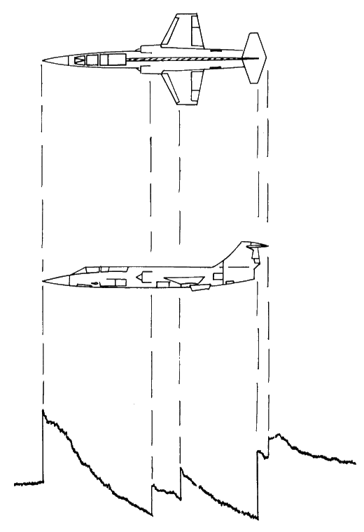
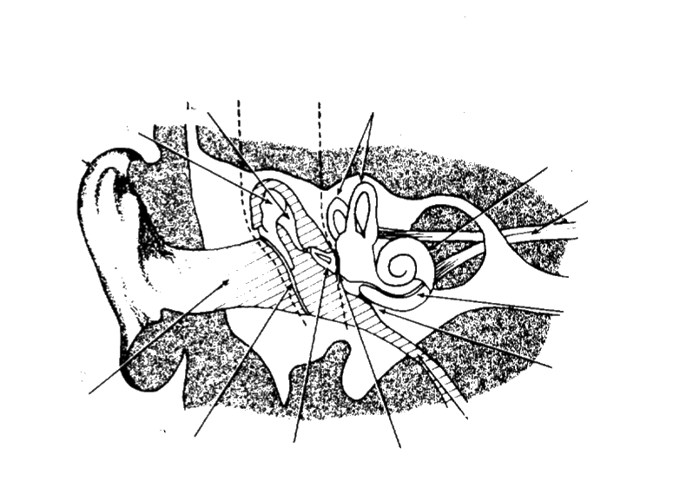
HUMAN RESPONSE
TO SONIC BOOMS
JOHN KARASINSKI
DECEMBER 1, 2016

Slide 2
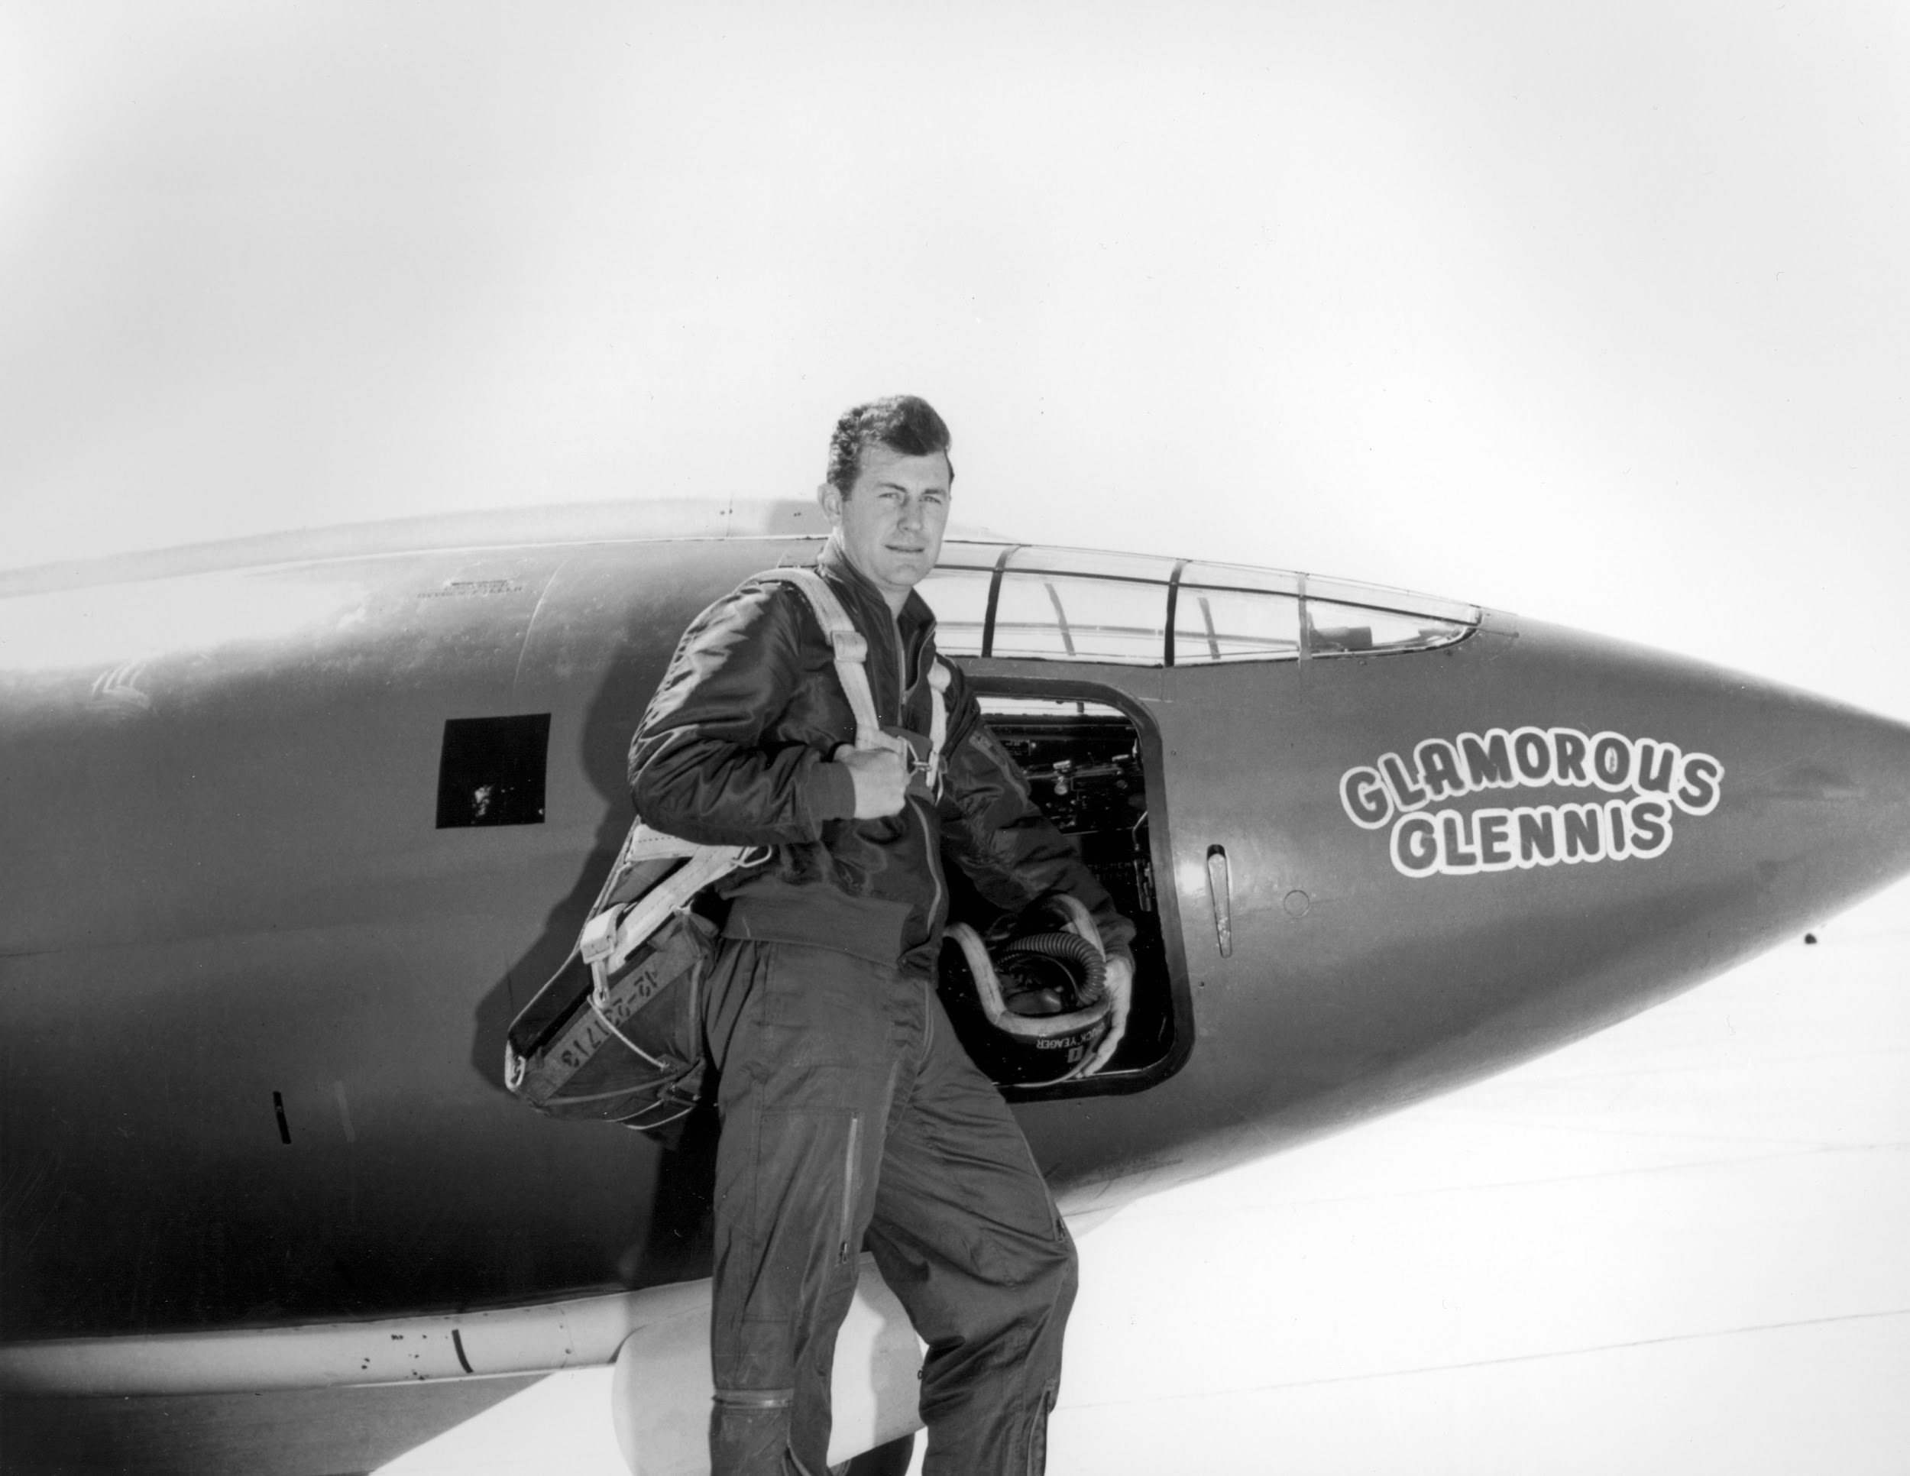
Chuck Yeager, Bell X-1 (1957)

Slide 3
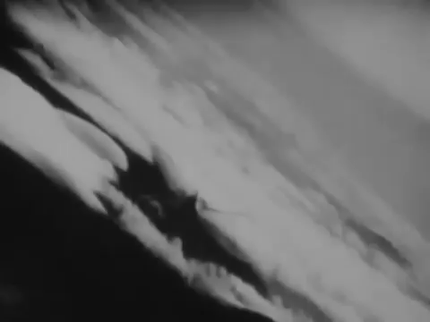

Slide 4
THE EARLY YEARS
1950 USAF
Correlate pressure with theory
Keep humans “far enough away”
Weapon?

Slide 5
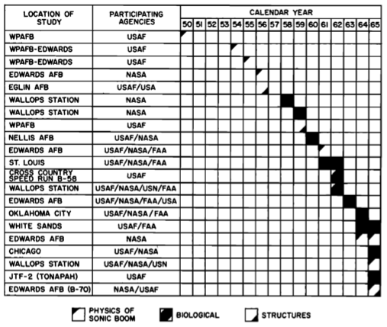

Slide 6
INITIAL EXPERIMENTS
Two aircraft at Mach 1.05-1.16
Unique wave shapes
Glass breakage
Test on humans within 50 feet

Slide 7
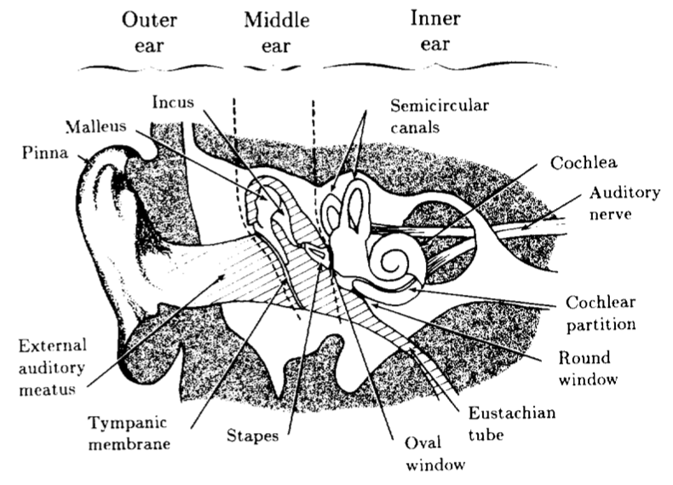

Slide 8
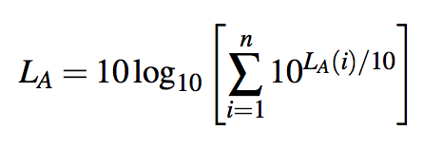
MANY NOISE METRICS
Predict loudness, or annoyance, or...
Sound Pressure Levels (SPL)
Yolo
SLA, LL_{S}, LL_{Z}, PNL, PL, EPNL...

Slide 9
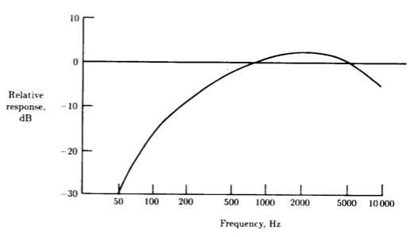

Slide 10
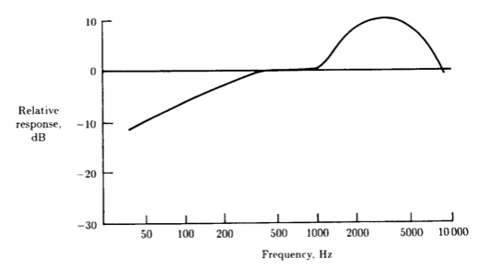

Slide 11
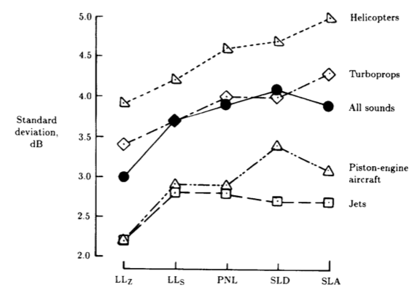

Slide 12
MODELLING BOOMS (PART 1)
N-wave signature
Rise time, P_{max}, Duration
Front-shock-minimized (FSM)
Front-shock rise time, secondary rise time, peak overpressure, front-shock overpressure

Slide 13
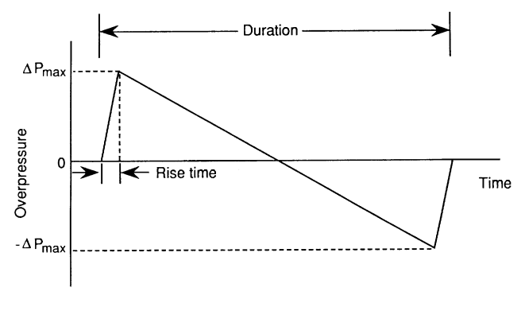

Slide 14
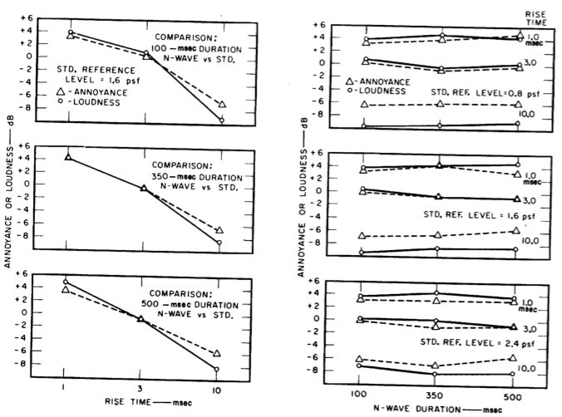

Slide 15
STARTLE RESPONSE
Short rise times -> Large annoyance
Abrupt, loud noises are startling
Can you adapt?

Slide 16
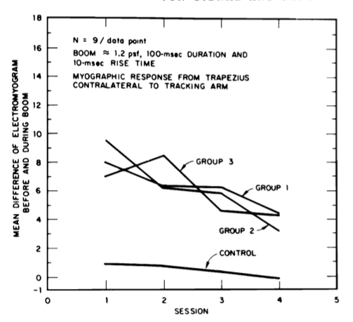

Slide 17
MODELLING BOOMS (PART 2)
N-wave signature
Rise time, P_{max}, Duration
Front-shock-minimized (FSM)
Front-shock rise time, secondary rise time, peak overpressure, front-shock overpressure

Slide 18
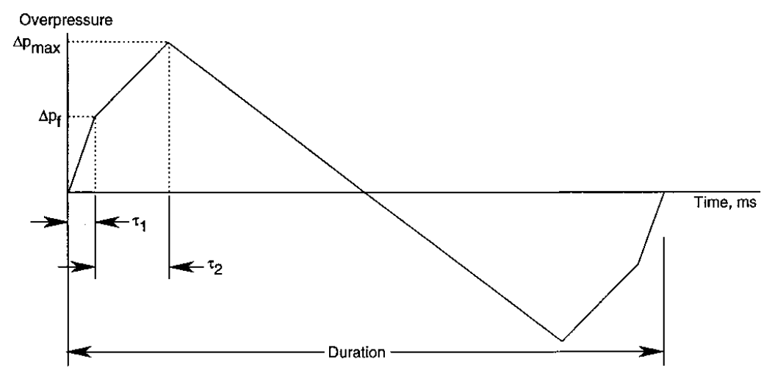

Slide 19
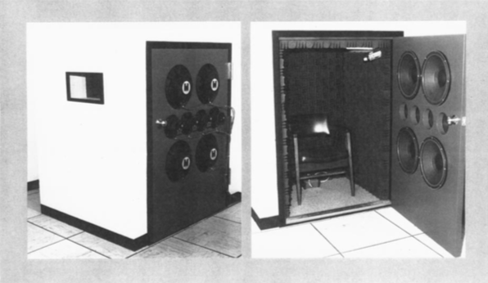
Notes:
NASA Langley Sonic Boom Simulator

Slide 20
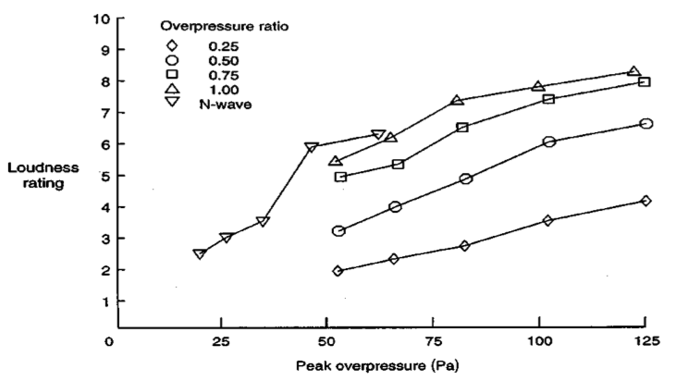

Slide 21
COMMERCIAL TRANSPORT
It would be nice to make money off this
Effects on the population?
Indoor vs outdoor perceptions

Slide 22
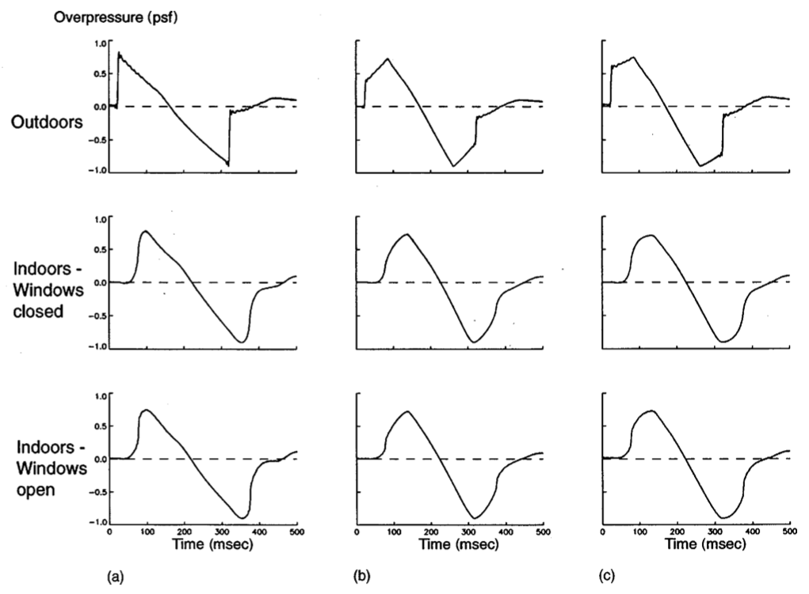

Slide 23
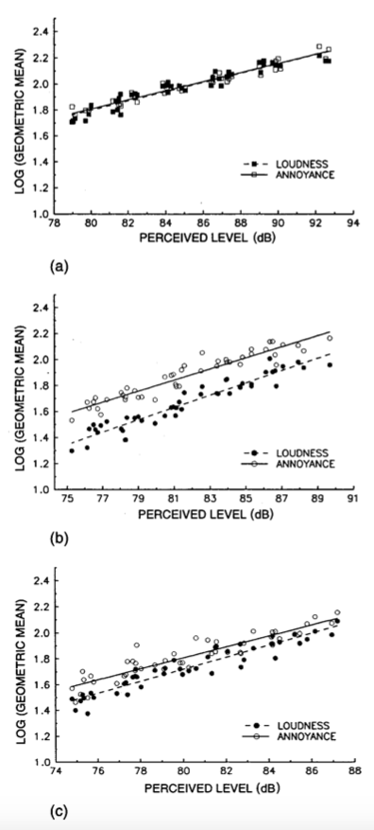

Slide 24
SUBJECT TESTING
So far this is modelling
Actual humans?

Slide 25
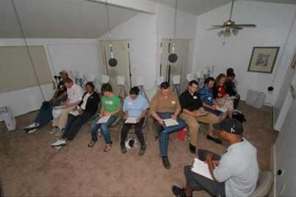
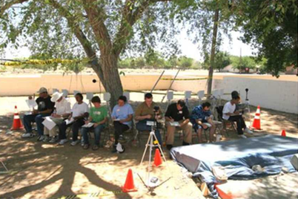

Slide 26
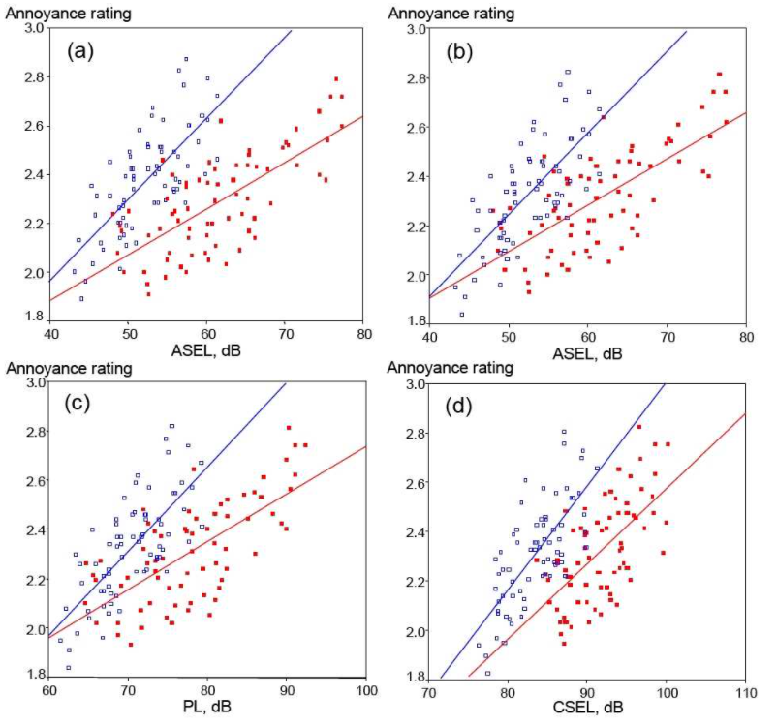

Slide 27
FUTURE RESEARCH
Still no clear agreement
Will aircraft ever be able to go supersonic over land?

Slide 28
